Slide 1
School-wide Positive Behavior Plan
SPBP
Tyyne Hogan

Slide 2
Objectives
After this presentation, you will know:
Why all schools need to complete a SPBP
How the SPBP is connected to PBIS
Where the SPBP template is located
Where to find the resources to complete the SPBP
What the template contains this year
When the SPBP is due
HINT: April 30
every year!
Notes:
By the end of this presentation, you will know:
* When the SPBP is due

Slide 3
Rationale
Does every school have to have a SPBP?
Yes, the SPBP is a part of the School Improvement Plan (SIP) and includes the BTU contracted discipline plan. Even if your school completes the state SIP they still need to complete the SPBP. It is also an embedded piece of Best Practice # 2: Ensuring High Quality Embedded RtI Processes.
Why?
The SPBP is the blueprint of your behavior curriculum. It needs to be documented and monitored for you to be able to evaluate the success of your curriculum. All schools, regardless of level or type, must have an individualized implementation plan submitted on the District’s template.
Notes:
Every school has to complete a SPBP as a part of their SIP. Regardless of level or type, schools need to chart out their academic curriculum programs to ensure that their students meet academic achievement, even if that curriculum needs to be differentiated or individualized. Similarly, * all schools need to have a behavior blueprint, clearly indicating the critical elements of a comprehensive Tier 1 behavior plan. *The SPBP template is found in OSPA Central in your SIP plan under Best Practice # 2, and teams can start working on it immediately.

Slide 4
Multi-Tiered System of Supports (MTSS)
The District’s Initiative
MTSS is a term used to describe an evidenced based model of schooling that uses data based problem solving to integrate academic and behavioral instruction and intervention. The integrated instruction and intervention is delivered to students in varying intensities (multiple tiers) based on student need.
Notes:
Just to quickly review, the SPBP lives in a multi tiered systems of support or MTSS. MTSS promotes data based problem solving for all aspects of school decisions and within all tiers of student need.

Slide 5
Multi-Tiered System of Support
RtI
Problem Solving Process
Multiple Tiers of Instruction & Intervention
Data Evaluation
Leadership
MTSS
Communication & Collaboration
Capacity Building Infrastructure
Notes:
Graphically, MTSS must contain all these components to build a comprehensive system. Altho all of these are essential and inter-twined, we are focusing on * the Implementation of multiple tiers of instruction and intervention with evidence based strategies matched to student needs. *This is RtI

Slide 6
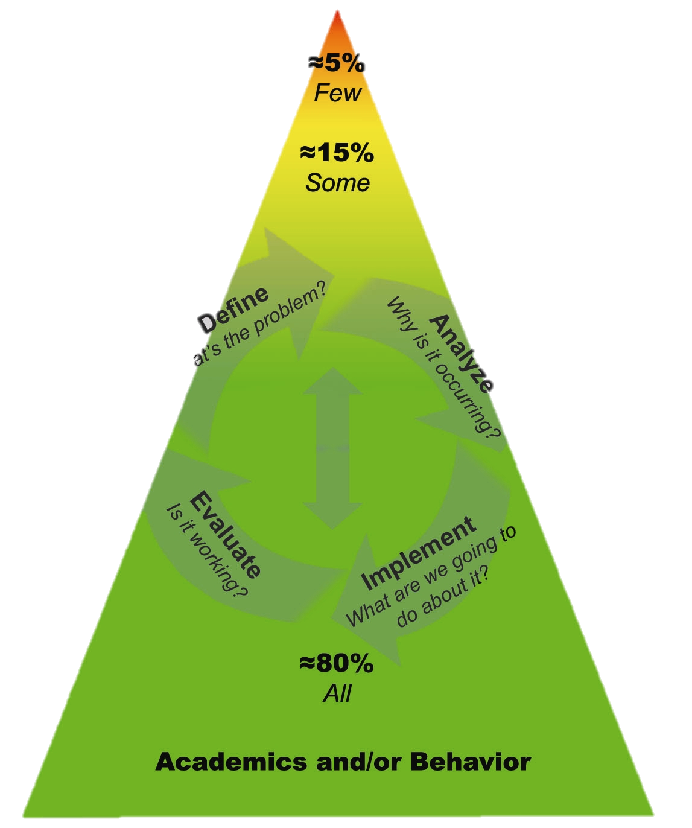
Response to Intervention
ACADEMIC SYSTEMS
Tier 3: Comprehensive & Intensive Students who need individualized interventions.
Tier 2: Strategic Interventions Students who need more support in addition to the core curriculum.
Tier 1: Core Curriculum All students, including students who require curricular enhancements for acceleration.
BEHAVIOR SYSTEMS
Tier 3: Intensive Interventions Students who need individualized intervention.
Tier 2: Supplemental Supports: Students who need more support in addition to school-wide positive behavior program.
Tier 1: Universal Interventions All students in all settings.
RtI:B / PBIS
SPBP
Notes:
6
This RtI triangle represents the tiers and contains 2 integrated systems; academic and *behavioral. The behavioral side is * often called RtI:B or Positive Behavior Interventions and Supports - PBIS
Collaborative Problem Solving Teams often use behavior data as part of their analysis to understand individual student needs – For example, they may look up how many referrals a student has, how their attendance has been affecting their academics, or even analyze behavior issues as compared to their peers. This is a common practice when determining supplemental supports or interventions at Tier 2 or 3.
However, *universal behavior screenings and school-wide interventions for all students at the Tier 1 level are imperative for managing the health your school’s climate. Your* SPBP is your core behavior curriculum for all students

Slide 7
Connection to PBIS
10 Critical Elements
1. Functioning RtI:B/Discipline Team
2. Faculty& stakeholder buy-in & commitment
3. School-wide Expectations with Lesson Plans
4. Location-based Rules with Lesson Plans
5. Effective Discipline Process and Procedures
6. Effective Reward/Recognition Program
7. Implementation Planning
8. Data-based decision making
9. Classroom Management System (CHAMPs)
10. Ongoing Progress Monitoring & Evaluation
Notes:
As some members on your team may remember, there are 10 Critical Elements in PBIS and we have been adding 1 to 2 elements each year until all 10 are included in the SPBP. This year we have added a * narrative question about your school-wide reward system and a *formula for you to analyze your core effectiveness. We have also expanded the * discipline process by looking at your school’s discipline flow chart.
These new elements will have * lightbulb before them in the SPBP template and an encouragement for your team to watch the specific Brainshark for that element.

Slide 8
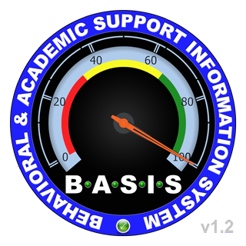
The “Big 5”
The Big 5: | Leading Questions:
Referral by student name | Who needs immediate support? Is the Core Behavioral curriculum effective?
Top 10 incidents (type of behavior) | What are the most common misbehaviors? How are they linked to the school’s Expectations and Rules?
Events by time of day Referrals by date (monthly) | How can we prevent spikes in behavior during the day and year?
Events by location | Where do we need extra support, structure, or planning?
Referral by grade level or teacher | What kind of support can we provide for teachers? Who needs the support? Are they trained in and implementing CHAMPs?
Notes:
The Big 5 are data points that help your team evaluate the implementation of your behavior curriculum. We currently have *3 of the Big 5 in our SPBP and you will need to know how to access the data.
All data for the Big 5 comes out of BASIS 3.0 in the Behavior Dashboard. The Dashboard provides you with many behavior graphs and charts so you can clearly and quickly determine your current behavior data. The Big 5 do not answer questions but leads the team to dig deeper in analyzing the data to provide an effective intervention.
I am first going to review where to find the 3 sets of data (and then Jeff is going to take you live into the dashboard and show you). This PPT is attached to this Webinar, so you can also print up the directions as well as seeing them.

Slide 10
Outcomes of Tier 1 PBIS
effectively and consistently implementing
PBIS
Build environments in which positive behavior is more effective than problem behavior
Is a collaborative, assessment-based approach to developing effective interventions for problem behavior
Emphasizes the use of preventative, teaching, and reinforcement-based strategies to achieve meaningful and durable behavior and lifestyle outcomes
Decrease in office discipline referrals & suspensions
Increase in student attendance
Increased academic engaged time for teachers and students
Improved school climate
Increased student and staff safety
Decreased staff absenteeism
23,363 SCHOOLS
IMPLEMENT TIER 1
PBIS IN U.S.A.
Notes:
The positive outcomes of implementing PBIS are well documented in our state and nationally. Implementing PBIS through your SPBP builds a positive environment for all stakeholders emphasizing the use of preventative teaching and reinforcement strategies. *And because behavior and academics are so inter-twined, the effects of having a positive school climate impacts student academic achievement.
Of course, for this impact, *PBIS has to be implemented effectively and consistently.

Slide 11
Who develops the SPBP?
Principal
CPS
Team
SPBP
Team
Discipline Team
Leadership Team
Behavior Committee
Notes:
The SPBP may be developed by * a current school team such as the CPS Team, the discipline team, the leadership team or a behavior committee. Or * it could be made up of members from these teams. It is the Principal who creates the foundation for this team to thrive by providing * structure and designated time for them to meet and complete the SPBP in a timely manner.

Slide 12
What does this team do?
Teams will:
Represent all major stakeholders of the school
Meet regularly throughout the year to collect and analyze Tier 1 behavior data
Create the SPBP, based on behavior data analysis
Share information with staff while developing SPBP
Hold a faculty vote on the SPBP
Submit the SPBP in OSPA v.2.0 by April 30th every year
Notes:
This team meets at least quarterly to discuss Tier 1 data. After analyzing behavior data and developing the plan, the team shares plan details, such as school-wide expectations, location-specific rules, and behavior lesson plans with their respective stakeholders for feedback. The final SPBP for the new year is voted on by faculty then submitted.

Slide 13
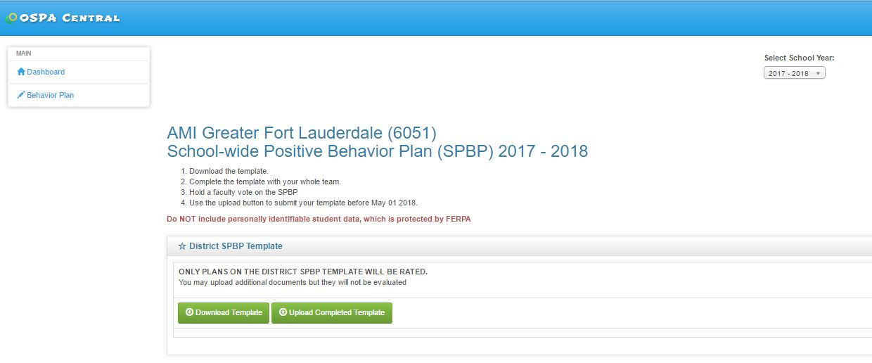
Template Location
2017-2018
Notes:
A template provides consistency in implementation and evaluation across the District; only SPBPs on the District template can be accepted.

Slide 14
Behavior Lesson Plans
Challenging!
Taught in classroom/small group settings
Created school-wide for consistency in language and expectations
Able to be replicated by any instructor
Specific resources
Detailed steps in lesson
Plan for teaching new students AND teachers
BEST
PRACTICES
Create a binder
Set a schedule
Reinforce teachers
Review data to modify
lessons as needed

Slide 15
Core Effectiveness
New!
A healthy behavior
core creates an
effective and equitable
distribution of the
resources in school
for all students
Notes:
Core Effectiveness is a new element in the SPBP this year. Core effectiveness measures the health of the behavior outcomes in a school. A healthy school has at least 80% of students receiving a maximum of 1 referral, less than 15% of students receiving 2 to 5 referrals and less than 5% receiving more than 5 referrals. A healthy school can manage all behavior referrals without drawing on too many resources.

Slide 16
Core Effectiveness
3%
7%
10%
20%
87%
School A
School B
Notes:
You can see in this pie chart, that at School A, 87% of the students receive a maximum of 1 referral. Only 10% received 2-5 referrals and 3% received more than 5 referrals. This is a healthy school. It doesn’t mean they don’t have work to do, but it means that they have an effective Tier 1 behavior curriculum.
*In School B, however, you see that only 73 % of students have received a maximum of 1 referral. This means that there are lot more students receiving 2 to 5 referrals and more than 5 referrals. This school has a tier 1 problem, meaning the behavior curriculum they are using is not effective for enough of their students. Schools *do not have the resources for addressing this many at risk students, so they need to strengthen their Tier 1 curriculum.

Slide 17
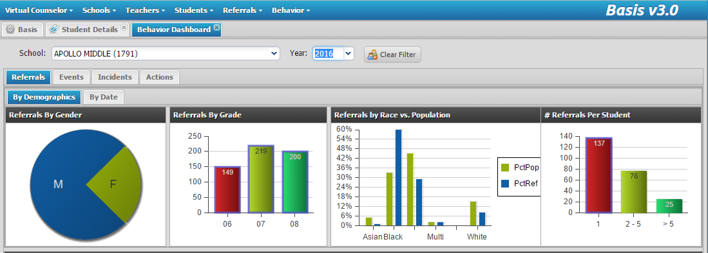
Core Effectiveness
Population = 1,276
Notes:
To determine the core effectiveness of your school, you will need to go again to *the Dashboard. Click on *Referrals by *demographics. The chart you need is on the* far right. This chart indicates that at this school,* 137 students had 0 to 1 referrals, 76 students 2 to 5 referrals and 25 students had more than 5 referrals. To figure out the core effectiveness, you will need the * school’s enrollment number; you can get this number from BASIS or your data person.

Slide 18
CRITICAL ELEMENT # 7: Data Collection and Analysis
1,276
137
92%
X
76
6%
X
25
2%
X
X
X
Notes:
The Data Collection chart in the SPBP template in Critical Element 7, takes you through the formulas to determine your core effectiveness. First, simply plug in your* numbers from BASIS. Then follow the * formula to determine each of your percentages. Finally, *compare the percentage with the recommended percentages.
Question* 7B asks your team to determine if your core is effective. Even if your core is effective, as it is with this school, you still need to focus on any at risk students. If all of your answers were * yes, explain how you will assist any returning at-risk students next year. If you answered * no to one or more, develop a short plan for strengthening your core.
So, those are the 3 data points you will be using in the SPBP template. Does anyone have any questions about those? You can just write in the chat box and we will answer them.

Slide 19
Resources
Overview Brainshark
http://www.brainshark.com/browardschools/Overview2017
8 Mini-Brainsharks
Teaming
Faculty Commitment
Expectations
Rules
Evaluation
Effective Discipline (expanded)
Reward Programs
Data Analysis
Less than 10 slides
Under 5 minutes each
“How to” complete the template
(not detailed instruction on elements)
http://www.browardprevention.org/mtssrti/rtib/
Notes:
There is an Overview Brainshark which all teams should watch. It contains some slides from this webinar but also contains further information for completing your SPBP correctly.
We are providing you with 8 mini-Brainsharks, one for each element. Although not mandatory to watch, these short Brainsharks will explain in detail and with examples, how to complete the SPBP correctly.
The URLs for all of these Brainsharks on attached to this webinar and you can download them for your team.

Slide 20
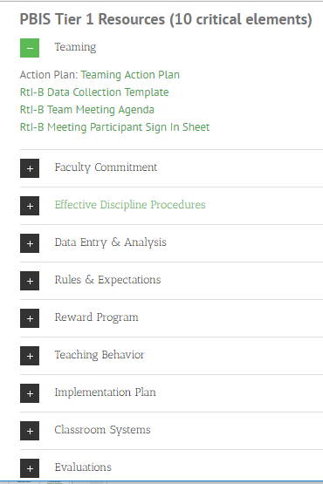
Resources
10 Critical Element Brainsharks
20-30 minutes each
Teaches the Critical Element in detail
so it can be implemented at the school
Provides the rationale and understanding
of each Critical Element
Great professional development for teams
Provides a solid review for PBIS schools
http://www.browardprevention.org/mtssrti/rtib/
BEST
PRACTICE
To become a PBIS school contact:
Tyyne.Hogan@browardschools.com
Notes:
Also, at the same website, you will find in-depth Brainsharks detailing each critical element, if you would like further information. These Brainsharks provide back ground, research, rationale, examples, and learning and implementation activities. There are also *resources and materials for each element. These 10 elements are covered during our 3 day PBIS training. If you are interested in becoming a certified PBIS school, please contact me.

Slide 21
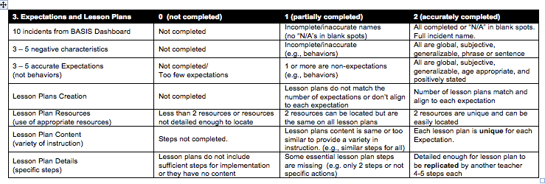
Resources
Use the Rating Rubric
Notes:
Use the Rating Rubric found in the Additional Items tab while you complete the SPBP template to make sure that you include all of the necessary criteria to create a comprehensive plan and receive full points. * For example, if your lesson plans are not detailed enough to be completed by any teacher, you will receive 0 points. However, * if you have at least 3 to 5 descriptive sentences that outline the steps of the behavior lesson, you will receive full points in that area.

Slide 22
Helpful Hints
BEST
PRACTICES
Don’t wait until April to start working on your SPBP
Complete a pre-SPBP survey with staff
Make it a multi-disciplinary team project
Explain to staff how it will provide a consistent
language across the school and will benefit them
Play the RtI:B 101 Brainshark for staff at a meeting
Obtain stakeholder’s feedback on updates
Hold your vote early to be able to make any needed
changes before the deadline
Become a PBIS school
Ask for help!
Pony your staff surveys
and receive Bonus
points!
Notes:
*You have the information you need to start working on your SPBP today. We all know testing is coming up and none of us has extra time to devote to the SPBP then. Start working on it as soon as possible.
*Ask staff for their input before you even start working on it. Attached is an anonymous staff survey you can use. Not only will this help your team to create a staff friendly SPBP and increase staff buy in, but you can also earn bonus points!
*This is not a project for one person. Ensure that you have a variety of representation on your team and especially an administrator who can support the implementation of your plan.
*Explain to staff the reasoning and purpose behind the SPBP; provide a rationale for the time and effort they will spend
*Give them some background information such as the RtI:B Brainshark
*Ask them for feedback along the way so you don’t get surprised by a vote that doesn’t pass
*Hold that vote early so you can get suggestions from staff and modify the SPBP as needed
And finally, * ask for help! If you are unsure of what you are supposed to do, please email me!

Slide 23
3
To receive 3 bonus points
Copy and disseminate the survey to all of your staff
Give staff sufficient time to complete and return to you
Collect and analyze survey data (or copy surveys for you)
Put all original surveys (and your school name) in a pony envelope
5. Send to: Tyyne Hogan, Lauderdale Manors Center, Room 1709
1. Must have a minimum of 50% of your staff complete the survey
2. Pony must be received before April 1
http://www.browardprevention.org/mtssrti/rtib/
Under “Additional Items”
Notes:
To receive your bonus points, simple pony your original surveys to me. I will send the Principal an email, indicating you have receive the additional points. Make sure you have at least 50% of your staff completing the survey to earn your points.

Slide 24
Contact
For more information on becoming a PBIS School,
contact tyyne.hogan@browardschools.com
Diversity, Prevention & Intervention
Lauderdale Manors Resource Center
754-321-1655
or visit our website at:
www.browardprevention.org
@ Broward, Prevention & Intervention
@ DiversityBCPS
Notes:
Thank you for watching this Webinar. I hope that you now have further understanding of the SPBP and will be able to confidently lead this initiative at your school. Please review the resources for more information. We will stay on the line for a few more minutes if anyone has any further questions. Otherwise, feel free to contact me, Tyyne Hogan, if you have any more questions or are interested in becoming a certified PBIS school.

